Slide 1
Statistical Methods for
ESA Agenda-Setting Analysis
Agnes Namyalo

Slide 2
Case Study — Media Attention and Congressional Attention to ESA
Question: Does media coverage of ESA events in month t predict congressional attention in month t+1?
News Articles
Congressional documents
Documents: 300 documents
Documents: 300 documents
Period: 1984 – 2025
Period: 1995 – 2025
Categories: 10 ESA meta-categories
Categories: 10 ESA meta-categories
Variable: news_t = count of listing articles
Variable: cong_t = count of listing documents
What kind of data do I have?
Counts, not measurements
Non-negative
Heavily zero-inflated, e.g., 359 of 371 months (96.8%) have cong_t = 0

Slide 3
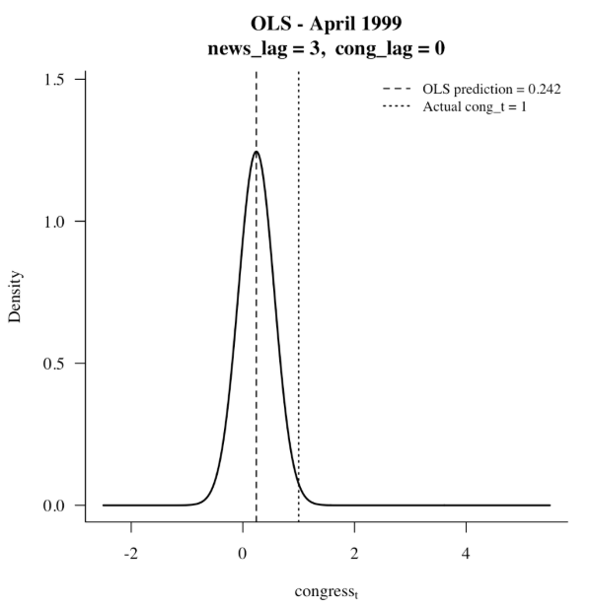
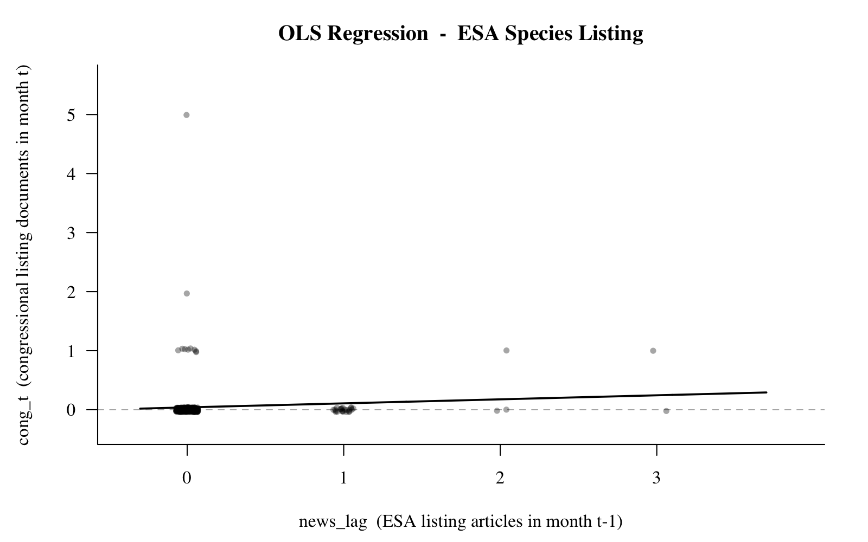
Describing the Response Variable — Congressional Listing Documents (cong_t)
R Summary Output
Data Summary Statistics
Parameter | value
n (months) | 371
Mean | 0.0458
Variance | 0.1030
Var / Mean | 2.2483
Min | 0
Median | 0
Max | 0
Zeros (0) | 359 (96.8%)
Non-zeros (n) | 12 (3.2%)
Skewness | 11.27
Problem:
96.8% structural zeros
Var > Mean
Right-skew (skewness=11.27)
cong_t violates every assumption of OLS. Count regression is required.

Slide 4
Use of Generalized Linear Models (GLM)
Approaches that allow the dependent variable to follow a different distribution
1
Poisson Regression
log(λ) = α + β₄×news_lag + β₃×cong_lag
λ = exp(α + β₄×news_lag + β₃×cong_lag)
Key Findings;
But Var=Mean assumption still violated (Var/Mean=2.25).
2
Quasi Poisson
log(λ) = α + β₄×news_lag + β₃×cong_lag
Var(cong_t) = φ × Mean(cong_t) where φ = dispersion parameter
Dispersion parameter: φ = Σ[(cong_t − λ̂)² / λ̂] / (n − p) = 2.50
Where:
cong_tᵢ = observed congressional document count in month i
λ̂ᵢ = fitted (expected) Poisson count in month i
n = number of observations (371 months)
p = number of estimated parameters (3: α, β₄, β₃)
n − p = degrees of freedom (368)
Σ = sum over all months i
Key Findings;
Poisson model, but allowing the dispersion parameter φ to be ≠ 1
Variance = φ × Mean
φ = 1 → standard Poisson (assumed) φ = 2.50 → variance is 2.5× what Poisson assumes

Slide 5
Use of Generalized Linear Models (GLM)
Approaches that allow the dependent variable to follow a different distribution
3
Negative Binomial
congress_t ~ NegBin(μ, θ)
log(μ) = α + β₄×news_lag + β₃×cong_lag → μ = exp(α + β₄×news_lag + β₃×cong_lag)
Variance = μ + μ²/θ (θ = dispersion parameter, estimated by maximum likelihood)
Where;
μ = expected count (same as λ in Poisson) — fitted from the model
μ²/θ = extra variance beyond Poisson — grows quadratically with μ
When θ → ∞ : Variance → μ (collapses to Poisson) θ → 0 : Variance >> μ (fat tails, extreme counts more likely)
Variance comparison at overall mean (μ = 0.046):
Model
Formula
Predicted Variance
vs Actual (0.103)
Poisson
Var = μ
0.046
Underestimates
Quasi-Poisson
Var = 2.50 × μ
0.115
Slightly overshoots
Negative Binomial
Var = μ + μ²/0.058
0.082
Closest to actual
Limitation: Negative Binomial still cannot separate structural zeros (Congress never crosses the threshold)

Slide 6
Use of Generalized Linear Models (GLM)
Approaches that allow the dependent variable to follow a different distribution
4
Hurdle Model
Why needed: 97% of the months with zeros can be modeled with two separate processes.
Sampling zero: In a month with low news coverage and no prior congressional activity, the expected count is near zero.
Structural zero: In this type of month, Congress would not produce an ESA listing document regardless of what the news coverage was.
PART 1 — Binary Hurdle (Logistic Regression): Does Congress produce any ESA listing document at all this month? OR Does Congress cross the threshold from zero attention to any attention at all?
P(cong_t > 0) = logistic(α₀ + β₄₀×news_lag + β₃₀×cong_lag) where logistic(x) = exp(x) / (1 + exp(x))
Where:
α₀ = baseline log-odds of any congressional activity (when both lags = 0)
β₄₀ = how each news article changes the log-odds of Congress crossing the attention threshold
β₃₀ = how prior congressional activity changes the log-odds of any activity this month
logistic() = converts log-odds to probability (always between 0 and 1)
PART 2 — Count Component (Negative Binomial): How many documents Congress produces, given Congress IS active?
cong_t | cong_t > 0 ~ NegBin(μ, θ) log(μ) = α₁ + β₄₁×news_lag + β₃₁×cong_lag (estimated from the 12 active months only — 359 structural zeros excluded)
Where:
α₁ = baseline log expected count when Congress IS active
β₄₁ = how each news article multiplies the expected count given Congress is already active
β₃₁ = persistence — prior activity effect on count intensity
θ = NB dispersion parameter
Key coefficients for news_lag:
β₄₀ (Part 1): Does media coverage increase the probability that ESA listing crosses the congressional attention threshold? OR It measures how much each additional news ESA listing article last month shifts the log-odds of crossing the threshold this month
β₄₁ (Part 2): Given Congress is already engaged, does more media coverage produce more documents?
The threshold is the point at which ESA listing becomes important enough for Congress to actually do something about it. Below the threshold, Congress ignores it completely. Above the threshold, Congress engages.
The Hurdle model answers both the threshold question and the intensity question simultaneously.

Slide 7
Key Findings
1
β₄ is positive in both OLS and Poisson
Media coverage last month predicts congressional activity this month — confirmed by both models. Each extra news article roughly doubles the expected count (exp(β₄)=2.04).
2
OLS is misspecified — must be rejected
OLS predicts 0.242 congressional documents — an impossible fraction. The wrong model produces untrustworthy results regardless of what it finds.
3
Overdispersion confirmed (Var/Mean = 2.25)
Poisson assumes Var=Mean. This is violated. Standard Poisson underestimates uncertainty and assigns unrealistically low probability to extreme months.
4
97% structural zeros require hurdle model
Congress is silent in 97% of months. A hurdle model separates structural silence from the count process — the right model for this data structure.
OLS → Poisson (baseline) → Negative Binomial (overdispersion) → Hurdle Model (structural zeros)

